Slide 1

SYD 366 Linda’s Holiday Store
Presented by Group 02:
Ashraf Bharot
Manav Zadafiya
Dev Patel
Arth Patel

Slide 2



Objective
As we all know, gathering customer feedback is crucial for any business. It provides invaluable insights into customer preferences, allowing us to tailor our product offerings to better meet their needs.
By implementing product surveys, Linda can now directly engage with her customers, gaining actionable insights for inventory management and ultimately improving satisfaction and loyalty.
Our Product Survey feature enables Linda's customers to provide feedback on products through surveys, empowering them to play a pivotal role in shaping Linda's inventory.
Through use cases such as creating surveys and submitting responses, we'll demonstrate how seamless and intuitive the process is for both administrators and customers.

Slide 3

Optimizing the Retail Experience
Implementing Product Surveys in Linda's retail software marks a significant step forward in our mission to enhance customer engagement and improve inventory management efficiency.
By leveraging direct feedback from customers, Linda can refine her product offerings, driving business growth and fostering stronger relationships with her clients.
Accompanying our explanations, you'll find visual aids such as class diagrams and sequence diagrams, illustrating the technical aspects of our implementation. These diagrams provide a clear overview of the system architecture and the flow of interactions between different components.
In conclusion, implementing Product Surveys in Linda's retail software marks a significant.

Slide 4

Key Features
Product Selection Options:
Users should be able to select the specific product(s) they are providing feedback on within the survey form.
This allows for targeted feedback related to individual products in the store.
Structured Questions:
The survey form should include a variety of structured questions related to the selected product(s).
Questions can cover aspects like product quality, design, pricing, availability, and overall satisfaction.
Open-Ended Questions:
In addition to structured questions, provide opportunities for users to provide open-ended comments and suggestions.
This allows customers to express their opinions freely and provide detailed feedback.
Rating Scales:
Use rating scales (e.g., 1 to 5 stars) for quantitative evaluation of different product attributes.
Rating scales provide standardized metrics for assessing customer satisfaction and preferences.

Slide 5
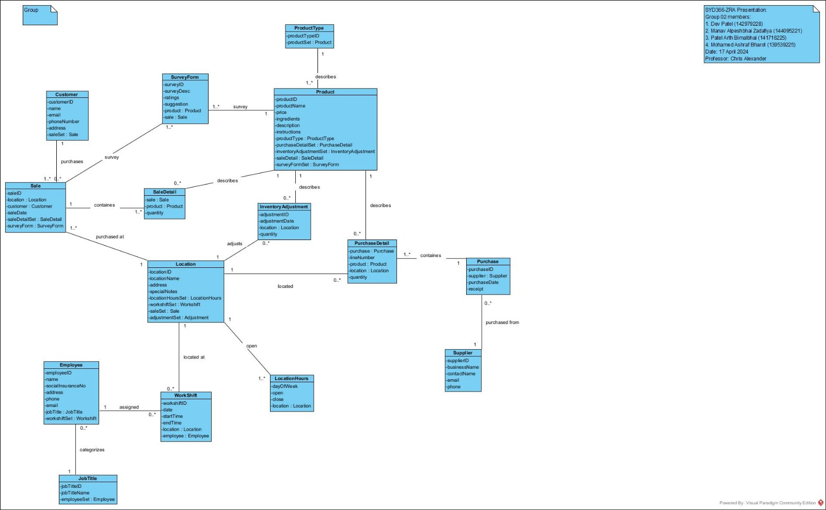
Class Diagram

Slide 6
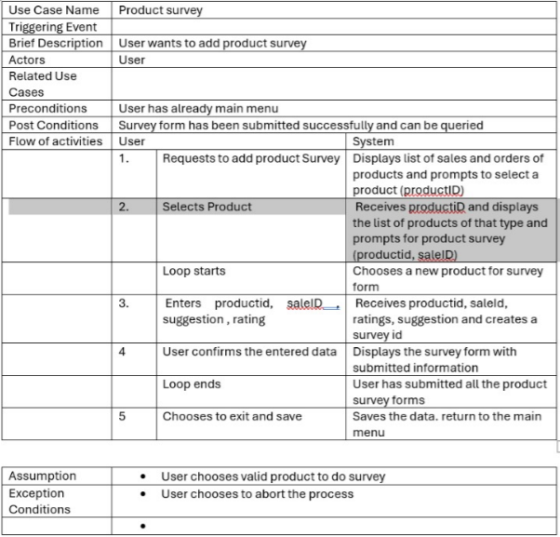
Case Description

Slide 7
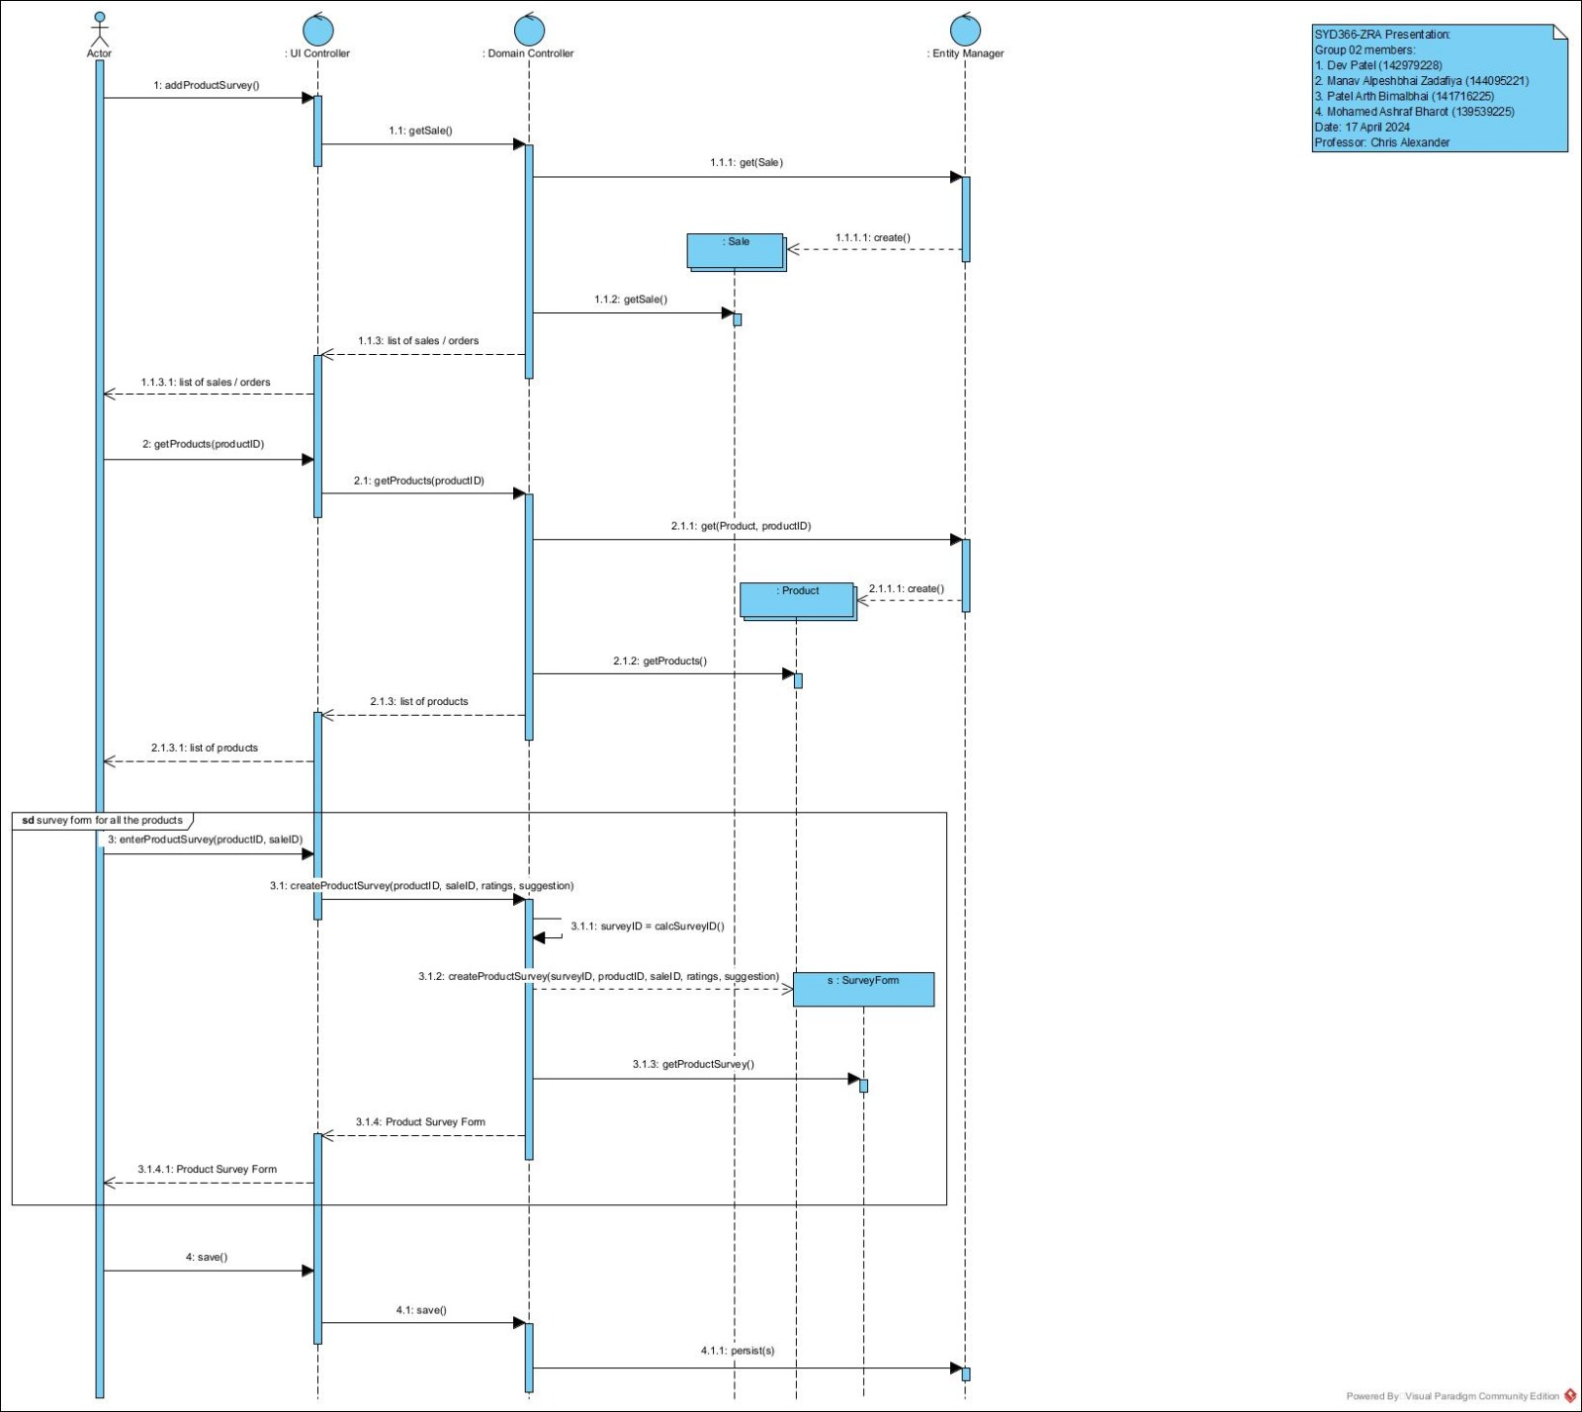
Adding Product Survey Sequence Diagram

Slide 8
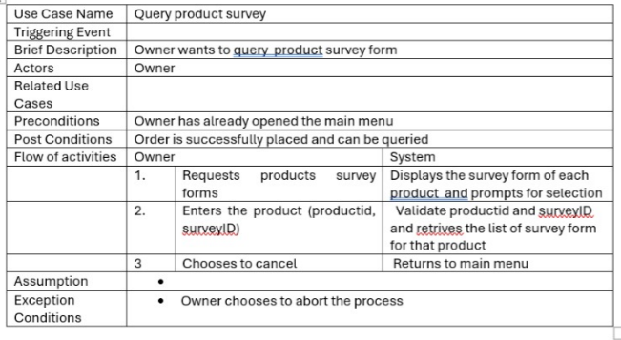
Case Description

Slide 9
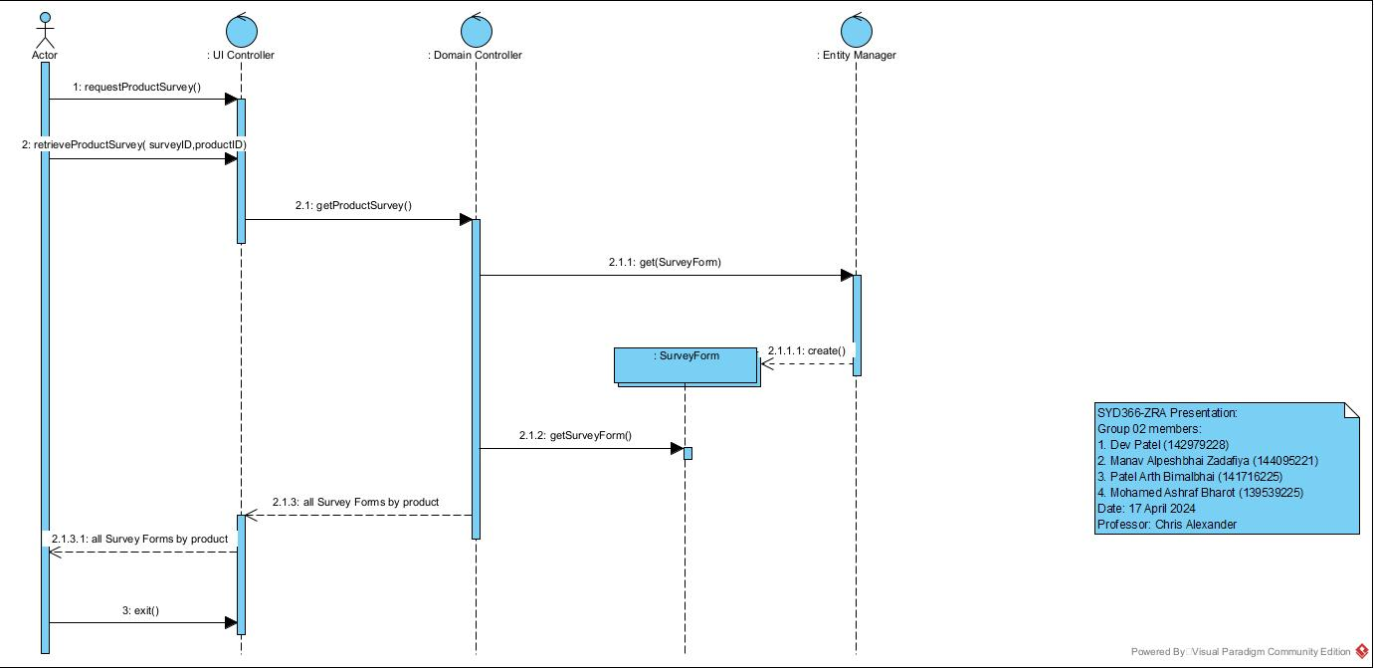
Product Survey Query Sequence Diagram

Slide 10
Conclusion
Implementing Product Surveys will empower Linda's business with valuable customer insights.
Enhance product offerings and customer satisfaction through direct feedback.
Drive business growth and improve inventory management efficiency.
Improve customer shopping experience

Slide 11
Thanks!
Do you have any questions?

